Slide 1
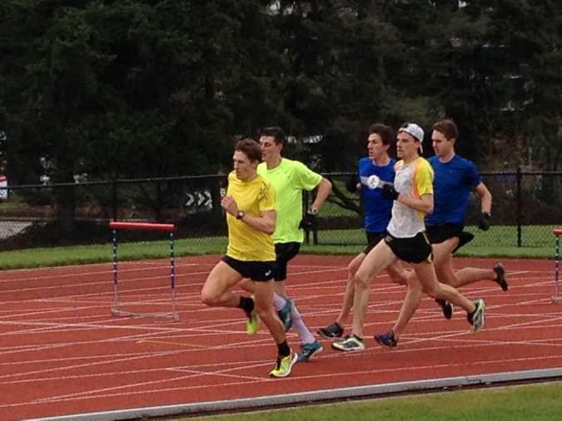
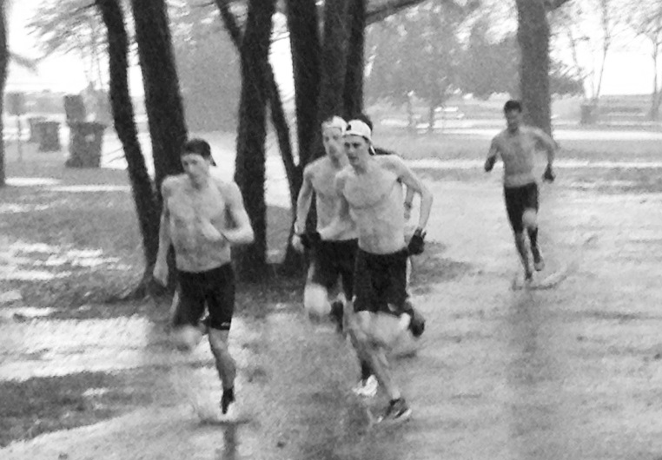
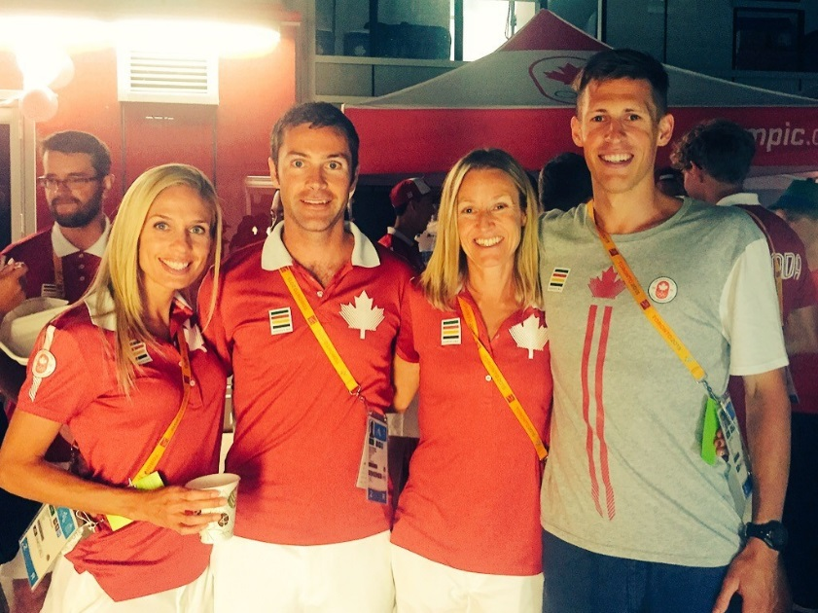
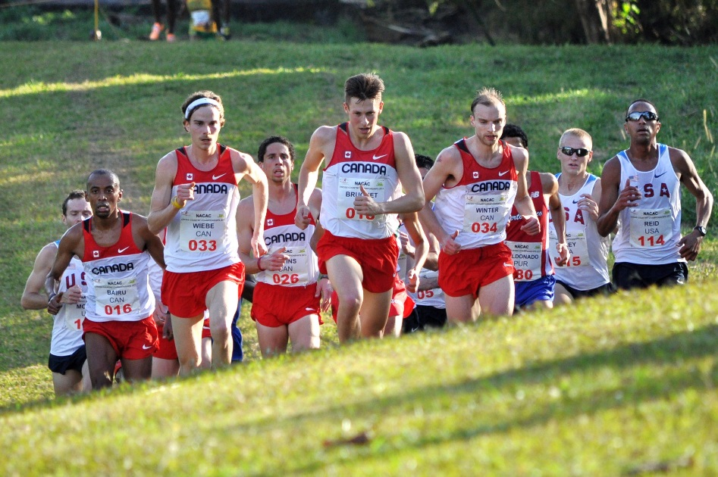
BC Endurance Project
A group of elite BC & Canadian distance runners training in the greater Vancouver area with Olympic Games aspirations.
Project goals are to place as many members on:
BC and Canadian Championship podiums
Canadian National teams
Podium performances at Olympic Games, World Championships, Multi-sport International Games and other international competitions.
Mission Statement
The BC High Performance Endurance Project (BCEP) strives to develop distance runners (5000m to marathon) to national and international performance standards. The specific goals of the project are to place as many members on BC and Canadian Championship podiums, on Canadian national teams and pursuing podium performances at international competitions.

Slide 2
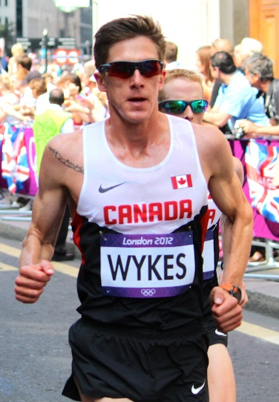
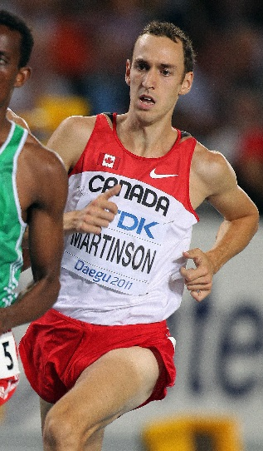
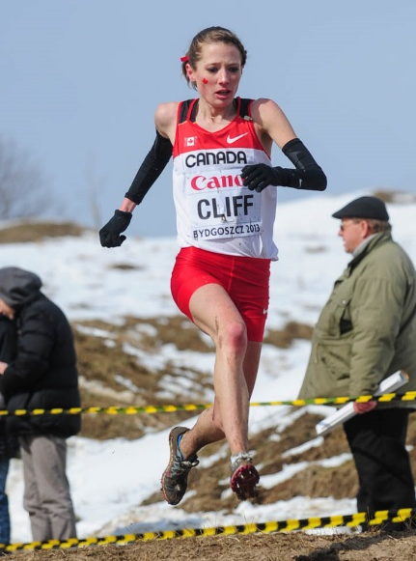
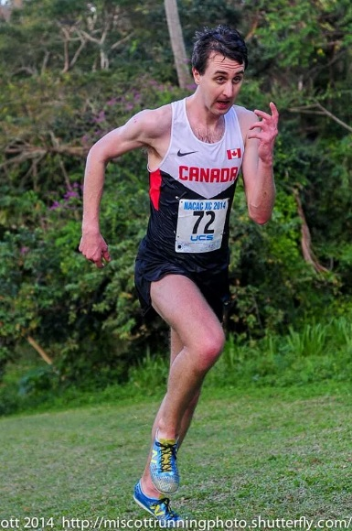
Dylan Wykes
2012 Olympian – marathon
2nd Fastest Canadian all-time – 2:10:47
Natasha Wodak
Canadian record holder – 10000m -31:41.59
2016 Rio Olympian -10000m
2015 Pan Am Games – 10000m
Luc Bruchet
2016 Rio Olympian – 5000m
2015 Pan Am Games – 5000m
2016 Canadian Ranking – 2nd (5000m)
Geoff Martinson
2011 IAAF World Championship semi-finalist – 1500m
2015 Canadian Ranking – 7th(5000m)
Rachel Cliff
2013 IAAF World Cross Country-25th
2016 Canadian Ranking – 3rd (5000m)
2016 Canadian Ranking – 3rd (10000m)
Theo Hunt
2014 Canadian Cross Country Team
Catherine Watkins
2015 Pan Am Games - marathon
Justin Kent
NAIA Champion – 3000m s/c
2015 Canadian Ranking – 9th(1500m)

Slide 3
Integrated Support Team
Physiotherapy
Chris Napier
Marilou Lamy
Sports Medicine
Dr. Jim Bovard
Exercise Physiology
Trent Stellingwerff, CSI
Nutrition
Elizabeth Gnatiuk, Fortius
Sports Psychology
Kirsten Barnes, CSI
Strength & Conditioning
Jon-Erik Kawamoto
Massage Therapy
Bobby Krudo
Chiropractic
Aaron Case
Kevin Friesen
2016 Canadian 10000m Bronze
2016 Canadian 10km Silver
2015 BC 10000m Champion

Slide 4
Canadian Championship Podiums
2015/16 Highlights
2016 Rio Olympics
Natasha Wodak (10000m)
Lucas Bruchet (5000m)
2015 IAAF World Track & Field Championships, China
Natasha Wodak – 10000m
2015 Pan Am Games, Toronto
Natasha Wodak – 10000m
Luc Bruchet – 5000m
Catherine Watkins – marathon
2015 IAAF World Cross Country Championships, China
Kelly Wiebe (50th)
Natasha Wodak (27th)
Natasha Wodak – 10000m Canadian record -31:41.51
23 (7 athletes)
Canadian Champions
6 (3 athletes)
National Team Members
18 Spots (7 athletes)
Canadian Records
1
Olympians
3

